Slide 1
Lab 1:
Robertson's Multiplication
  You will be given:
  test bench
  complete top level design (SystemVerilog model)
  all submodules instantiated and connected
  submodules
  some are complete, ready to use
  some are empty SystemVerilog shells
  translate (commented) C or pseudocode into Verilog

Slide 2
2’s Complement Theory
Binary representation of integers (or fractions)
Can represent both positive and negative integers
An n-bit number can represent the range [ -2^{n-1}, 2^{n-1} )
  The maximum representable negative integer does not have a corresponding positive representation
Each bit has an associated positional weight
  In 2’s complement notation, each bit can be considered to carry a positive positional weight, except for the MSB which is considered negative.
  The sum of the weights corresponding to ‘1’ bits is the value of the 2’s complement number.
Example:
(1101)₂
2⁰ + 2² + (-2³) = 1 + 4 – 8 = -3
Check: Flip the bits and add 1 for opposite sign representation
(1101)₂ → (0011)₂ = (3)₁₀
Negative Weight

Slide 3
Binary Addition and Overflow
Overflow occurs when the addition result is too large to fit in the given bit width
  The sum of two n-bit integers may be larger than what can be represented with n-bits.
  No more than n+1 bits are necessary to accurately represent the sum of any two n-bit integers
In signed addition, there are scenarios where overflow is not possible
  In addition, overflow cannot occur if the operands are of opposite sign.
  Similarly, in subtraction, overflow cannot occur if the operands are of the same sign.
The occurrence of overflow does not mean the addition result is useless
  Depending on the context, the result with overflow may still be restored to the correct result
    Additional word growth
    Carry out to a higher "slice," as in double- or quad-precision work
    modulo 2**N arithmetic (we'll see this in Lab 2, with clocks and calendars)

Slide 4
Overflow Examples
0110 (6)₁₀
+ 0101 (5)₁₀
1011 (-5)₁₀
0101 (5)₁₀
- 1101 (-3)₁₀
1000 (-8)₁₀
Overflow Possible
0111 (7)₁₀
+ 1011 (-5)₁₀
0010 (2)₁₀
0110 (6)₁₀
- 0101 (5)₁₀
0001 (1)₁₀
Overflow Not Possible
1101 (-3)₁₀
+ 1010 (-6)₁₀
1 0111 (-9)₁₀
0101 (5)₁₀
- 1101 (-3)₁₀
0 1000 (8)₁₀
Overflow Corrected
Extra headroom allows overflow to be corrected.
How do we determine the value of this bit?

Slide 5
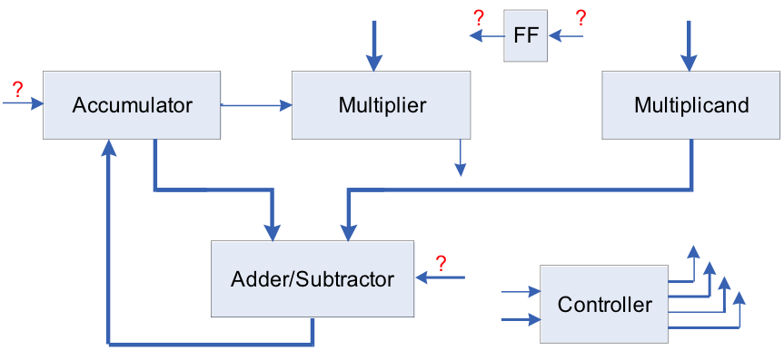
2’s Comp Robertson’s Multiplication
Robertson's Algorithm
Accumulate a partial sum in multiple steps -- just like grade school.
The rightmost bit of the multiplier is checked on every step to determine if the multiplicand should be added to the partial sum.
Shift the partial sum and the multiplier one bit to the right on every step.
  Make the partial sum line up with the multiplicand;
  Always check the rightmost bit of multiplier, no need to check higher bits;
  Lower bits of the partial sum shifted into the multiplier register for storage.
Subtraction step at the end for negative multiplicands.

Slide 6
Multiplication Example
----- register r -----
accumulator
multiplier
multiplicand
1010₂ * 1100₂
step1:
0000
1100
1010
right shift
1010 multiplicand
1100 multiplier
00000000
0000000
111010 (add 1010, sign ext.)
00110 (sub 1010)
00011000 result
step2:
0000
0110
1010
right shift
step3:
0000
0011
1010
accumulator = accumulator + multiplicand
1010
0011
1010
right shift
correction step:
1101
0001
1010
accumulator = accumulator - multiplicand
0011
0001
1010
right shift
0001
1000
1010
Result: 00011000

Slide 7
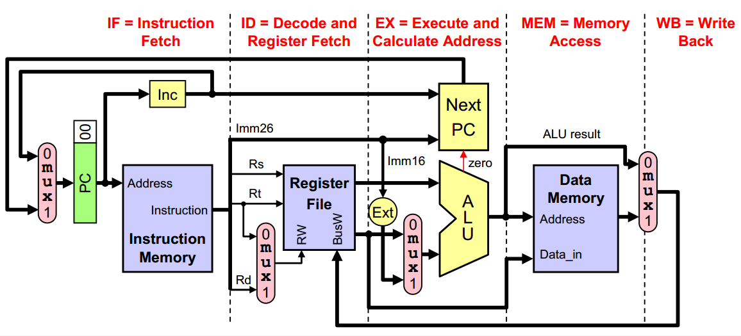
Control Logic = Program Counter + Instruction Memory + Instruction Decoder
Data Path = ALU + Register File

Slide 8
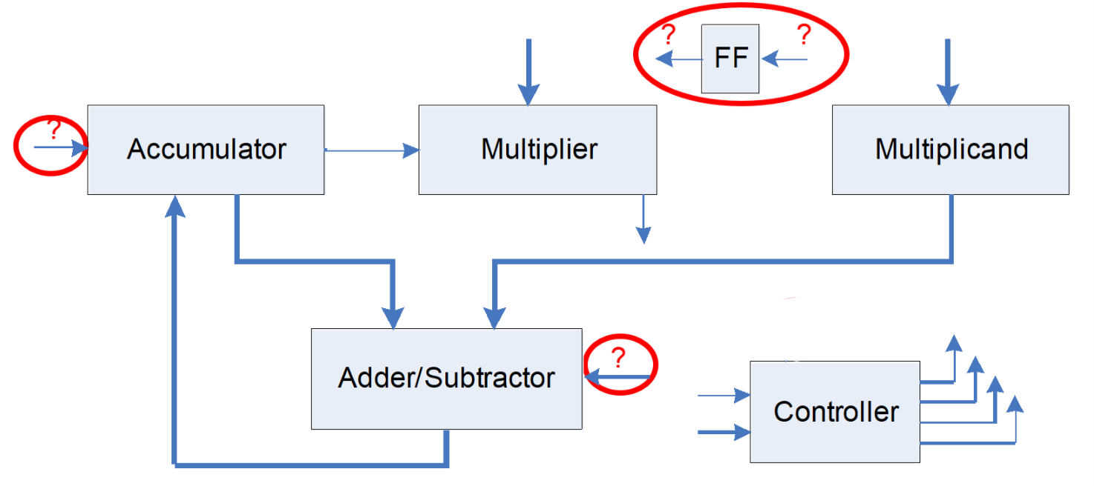
Glue Logic
D Flip Flop -- has clear and load enable instructions
The most significant bit of the accumulator during a shift
  Different in each part of the lab
The A/S signal for the adder/subtractor.
  Add if A/S = 0; subtract if A/S = 1.

Slide 9
Verilog Components
N-bit (parameteric) Shift Register:
  When LD is set, the parallel data input is loaded into the shift register;
  When SH is set, the content of the register is shifted 1-bit right, with the most significant bit fed by SI.
N-bit Adder-Subtractor:
  Output Q(N-1:0) = A(N-1:0)+/-B(N-1:0);
Control Unit:
  Handles the multi-cycle process by indicating to each device what to do on every cycle until the entire process is finished.
  This is equivalent to a RISC processor's program counter
  Every other component just follows instructions

Slide 10
Verilog Implementation
Given Modules:
  Anything not listed below is complete; use as-is.
Fill-in-the-Guts Specific Components
  shift_register.sv: shifts input 1 bit to right
  register.sv: has clear and load enable controls
  register_hl.sv: loads upper and lower halves
  addsub.sv: Adder/Subtractor
  counter_down.sv
  mux2,3,5
  rom.sv
  upc_reg.sv
  You may search for examples online and adapt them for this assignment.

